Slide 1

Clustering
Dr. Faisal Kamiran
DR. FAISAL KAMIRAN
INFORMATION TECHNOLOGY UNIVERSITY

Slide 2
What is Cluster Analysis?
Finding groups of objects such that the objects in a group will be similar (or related) to one another and different from (or unrelated to) the objects in other groups
Inter-cluster distances are maximized
Intra-cluster distances are minimized
Dr. Faisal Kamiran Information Technology University of The Punjab

Slide 3
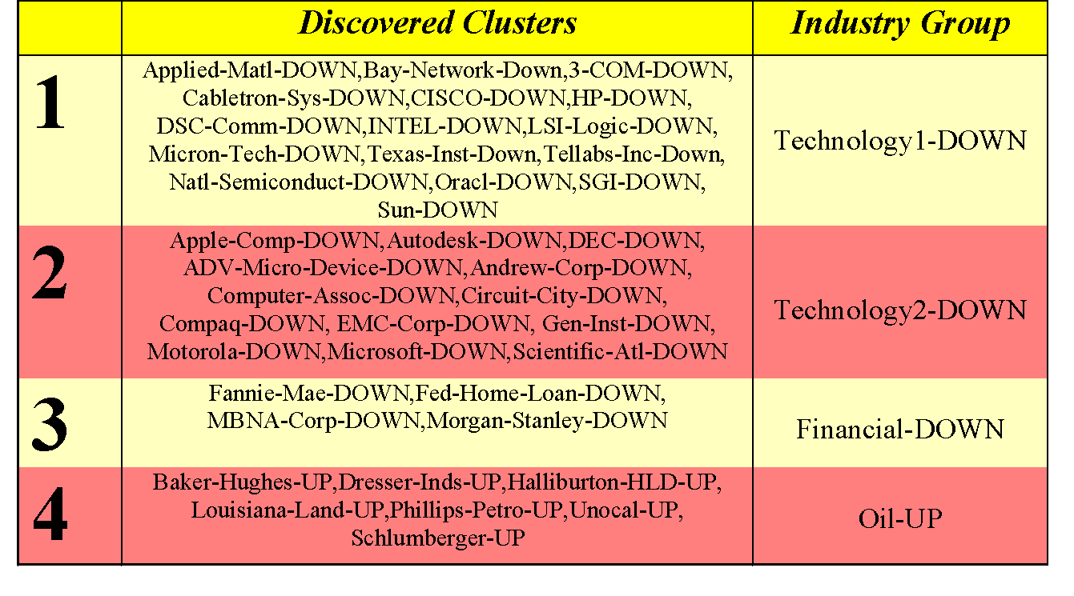
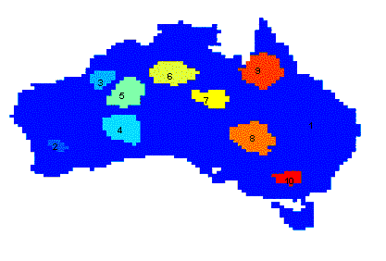
Applications of Cluster Analysis
Understanding
Group related documents for browsing, group genes and proteins that have similar functionality, or group stocks with similar price fluctuations
Summarization
Reduce the size of large data sets
Clustering precipitation in Australia
Dr. Faisal Kamiran Information Technology University of The Punjab

Slide 4
What is not Cluster Analysis?
Supervised classification
Have class label information
Simple segmentation
Dividing students into different registration groups alphabetically, by last name
Results of a query
Groupings are a result of an external specification
Dr. Faisal Kamiran Information Technology University of The Punjab

Slide 5
Notion of a Cluster can be Ambiguous
How many clusters?
Six Clusters
Two Clusters
Four Clusters
Dr. Faisal Kamiran Information Technology University of The Punjab

Slide 6
Types of Clusterings
A clustering is a set of clusters
Important distinction between hierarchical and partitional sets of clusters
Partitional Clustering
A division of data objects into non-overlapping subsets (clusters) such that each data object is in exactly one subset
Hierarchical clustering
A set of nested clusters organized as a hierarchical tree
Dr. Faisal Kamiran Information Technology University of The Punjab

Slide 7
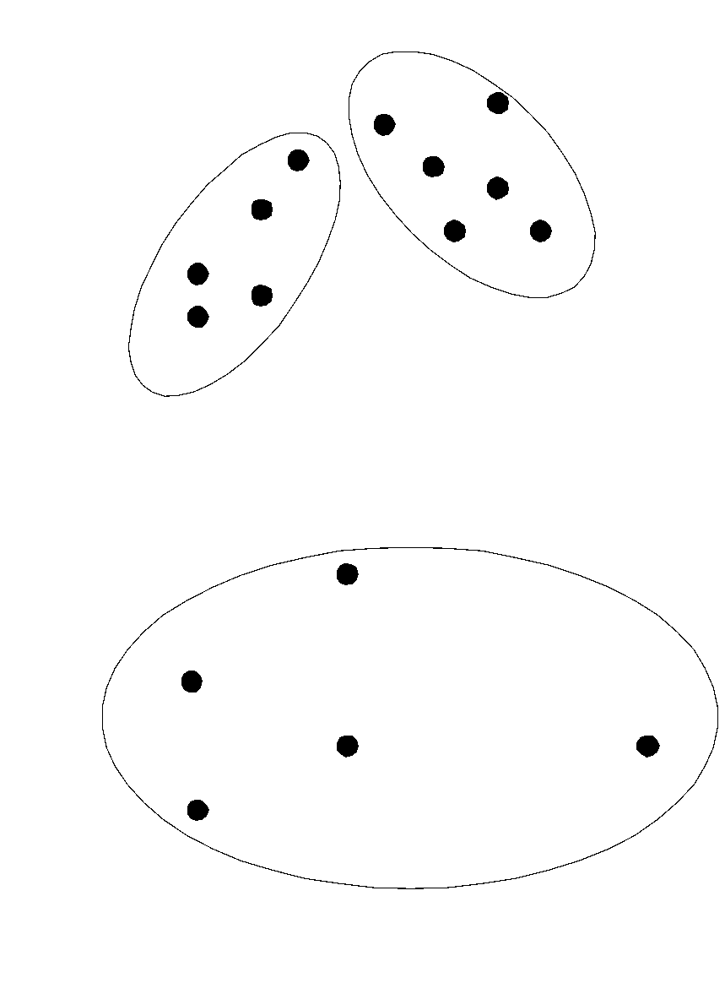
Partitional Clustering
Original Points
A Partitional Clustering
Dr. Faisal Kamiran Information Technology University of The Punjab

Slide 8
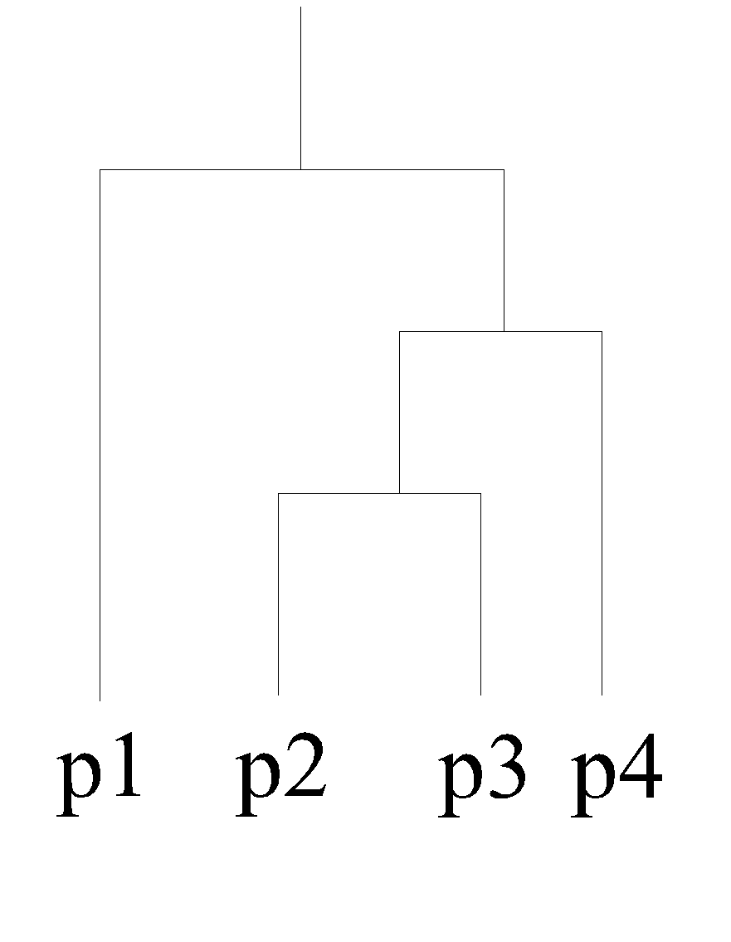
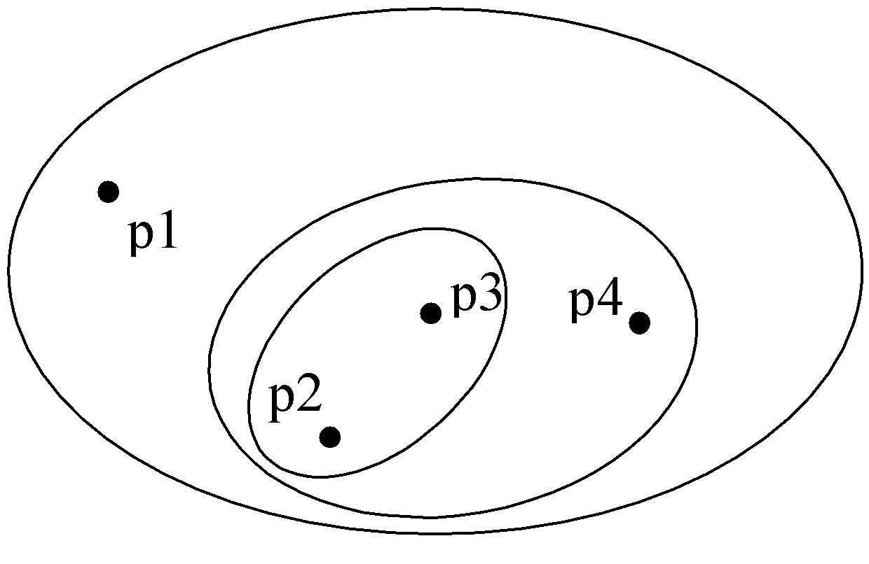
Hierarchical Clustering
Traditional Hierarchical Clustering
Traditional Dendrogram
Dr. Faisal Kamiran Information Technology University of The Punjab

Slide 9
Other Distinctions Between Sets of Clusters
Exclusive versus non-exclusive
In non-exclusive clusterings, points may belong to multiple clusters.
Can represent multiple classes or ‘border’ points
Fuzzy versus non-fuzzy
In fuzzy clustering, a point belongs to every cluster with some weight between 0 and 1
Weights must sum to 1
Probabilistic clustering has similar characteristics
Partial versus complete
In some cases, we only want to cluster some of the data
Heterogeneous versus homogeneous
Cluster of widely different sizes, shapes, and densities
Dr. Faisal Kamiran Information Technology University of The Punjab

Slide 10
Types of Clusters
Well-separated clusters
Center-based clusters
Contiguous clusters
Density-based clusters
Property or Conceptual
Described by an Objective Function
Dr. Faisal Kamiran Information Technology University of The Punjab

Slide 11
Types of Clusters: Well-Separated
Well-Separated Clusters:
A cluster is a set of points such that any point in a cluster is closer (or more similar) to every other point in the cluster than to any point not in the cluster.
3 well-separated clusters
Dr. Faisal Kamiran Information Technology University of The Punjab

Slide 12
Types of Clusters: Center-Based
Center-based
A cluster is a set of objects such that an object in a cluster is closer (more similar) to the “center” of a cluster, than to the center of any other cluster
The center of a cluster is often a centroid, the average of all the points in the cluster, or a medoid, the most “representative” point of a cluster
4 center-based clusters
Dr. Faisal Kamiran Information Technology University of The Punjab

Slide 13
Types of Clusters: Density-Based
Density-based
A cluster is a dense region of points, which is separated by low-density regions, from other regions of high density.
Used when the clusters are irregular or intertwined, and when noise and outliers are present.
6 density-based clusters
Dr. Faisal Kamiran Information Technology University of The Punjab

Slide 14
Types of Clusters: Conceptual Clusters
Shared Property or Conceptual Clusters
Finds clusters that share some common property or represent a particular concept.
.
2 Overlapping Circles
Dr. Faisal Kamiran Information Technology University of The Punjab

Slide 15
Types of Clusters: Objective Function
Clusters Defined by an Objective Function
Finds clusters that minimize or maximize an objective function.
Enumerate all possible ways of dividing the points into clusters and evaluate the `goodness' of each potential set of clusters by using the given objective function. (NP Hard)
Can have global or local objectives.
Hierarchical clustering algorithms typically have local objectives
Partitional algorithms typically have global objectives
Dr. Faisal Kamiran Information Technology University of The Punjab

Slide 16
Characteristics of the Input Data Are Important
Type of proximity or density measure
This is a derived measure, but central to clustering
Sparseness
Dictates type of similarity
Adds to efficiency
Attribute type
Dictates type of similarity
Type of Data
Dictates type of similarity
Other characteristics, e.g., autocorrelation
Dimensionality
Noise and Outliers
Type of Distribution
Dr. Faisal Kamiran Information Technology University of The Punjab

Slide 17
Clustering Algorithms
K-means and its variants
Hierarchical clustering
Density-based clustering
Dr. Faisal Kamiran Information Technology University of The Punjab

Slide 18
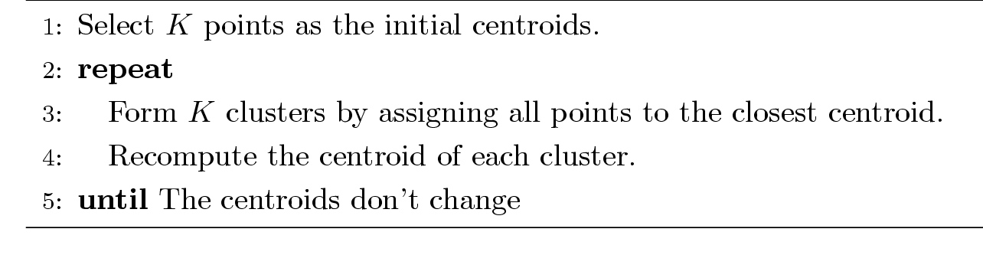
K-means Clustering
Partitional clustering approach
Each cluster is associated with a centroid (center point)
Each point is assigned to the cluster with the closest centroid
Number of clusters, K, must be specified
The basic algorithm is very simple
Dr. Faisal Kamiran Information Technology University of The Punjab

Slide 19
K-means Clustering – Details
Initial centroids are often chosen randomly.
Clusters produced vary from one run to another.
The centroid is (typically) the mean of the points in the cluster.
‘Closeness’ is measured by Euclidean distance, cosine similarity, correlation, etc.
K-means will converge for common similarity measures mentioned above.
Most of the convergence happens in the first few iterations.
Often the stopping condition is changed to ‘Until relatively few points change clusters’
Complexity is O( n * K * I * d )
n = number of points, K = number of clusters, I = number of iterations, d = number of attributes
Dr. Faisal Kamiran Information Technology University of The Punjab

Slide 20
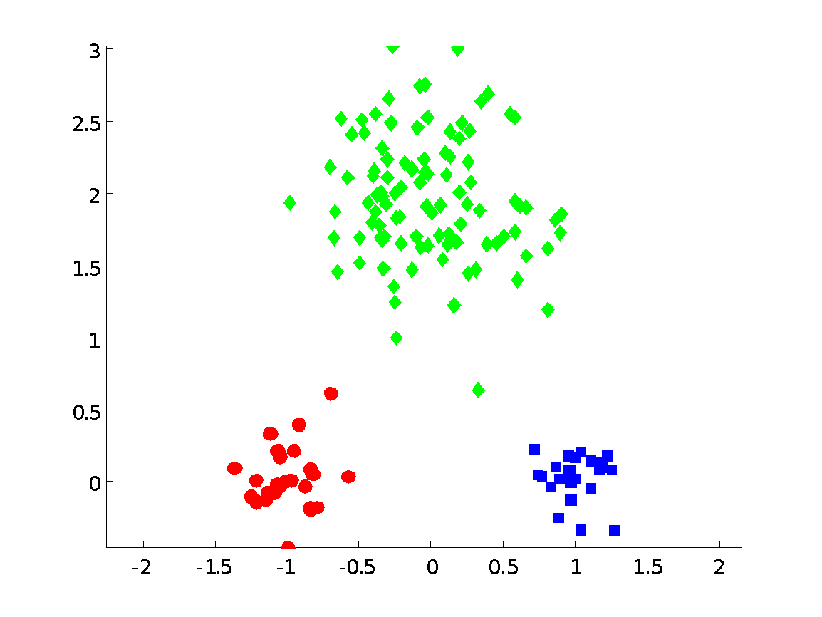
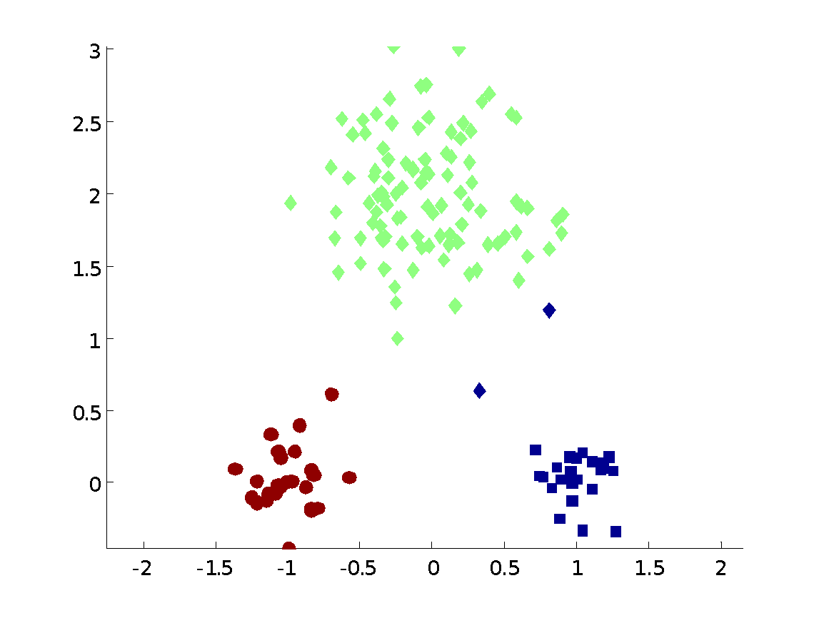
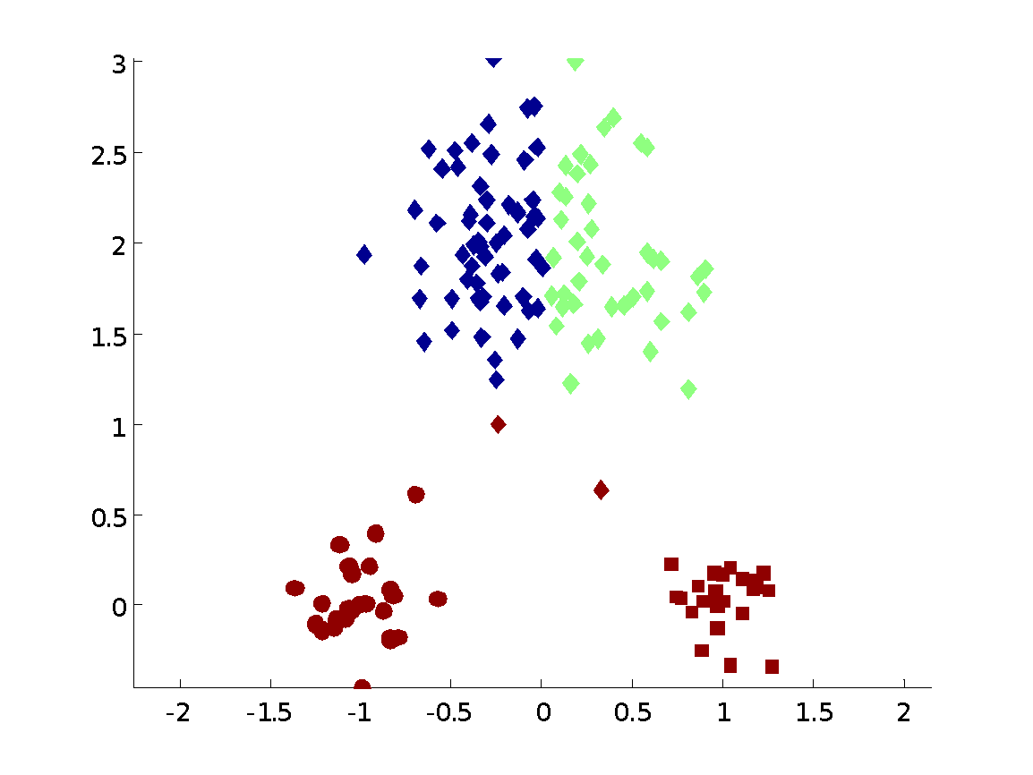
Two different K-means Clusterings
Original Points
Optimal Clustering
Sub-optimal Clustering
Dr. Faisal Kamiran Information Technology University of The Punjab

Slide 21
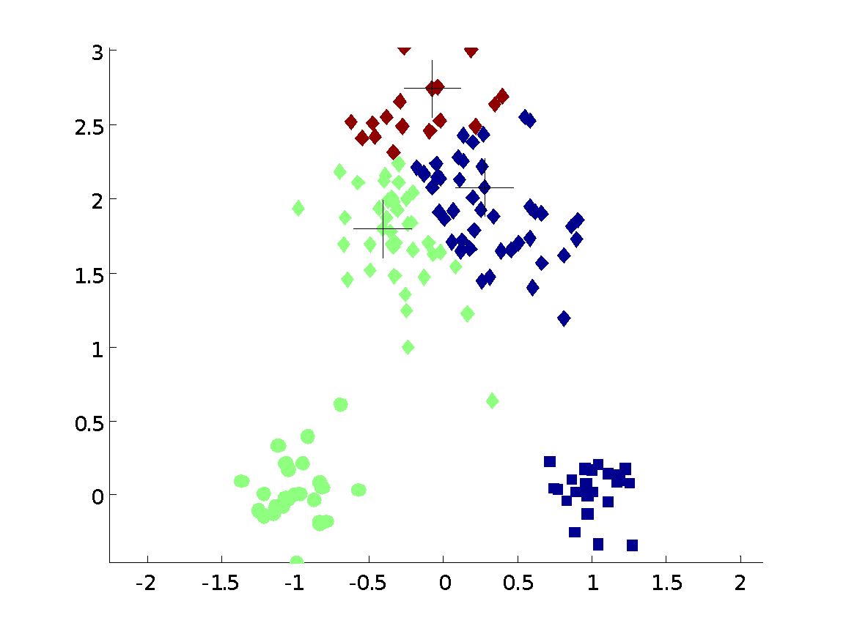
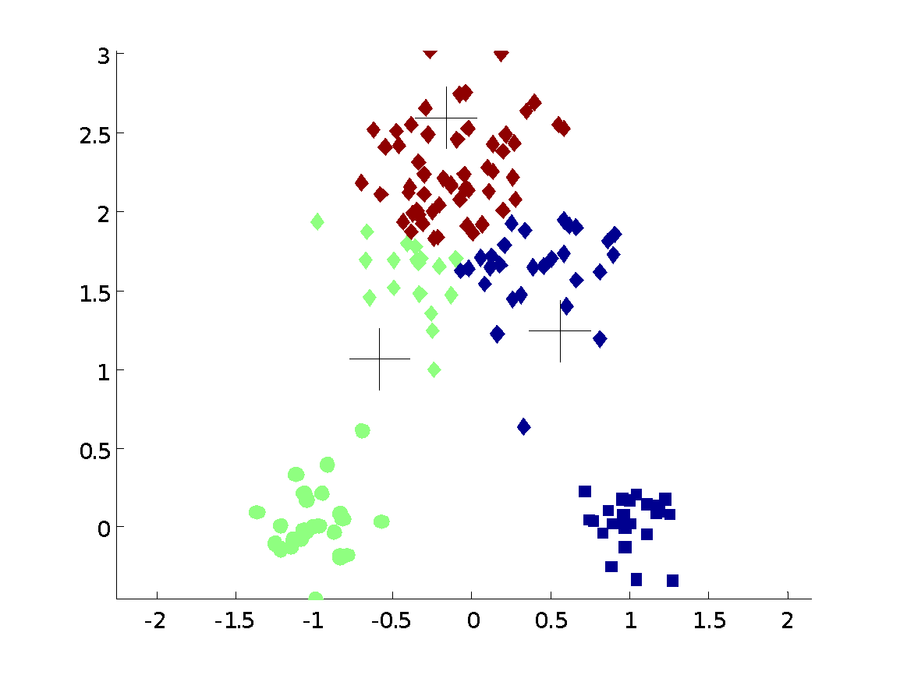
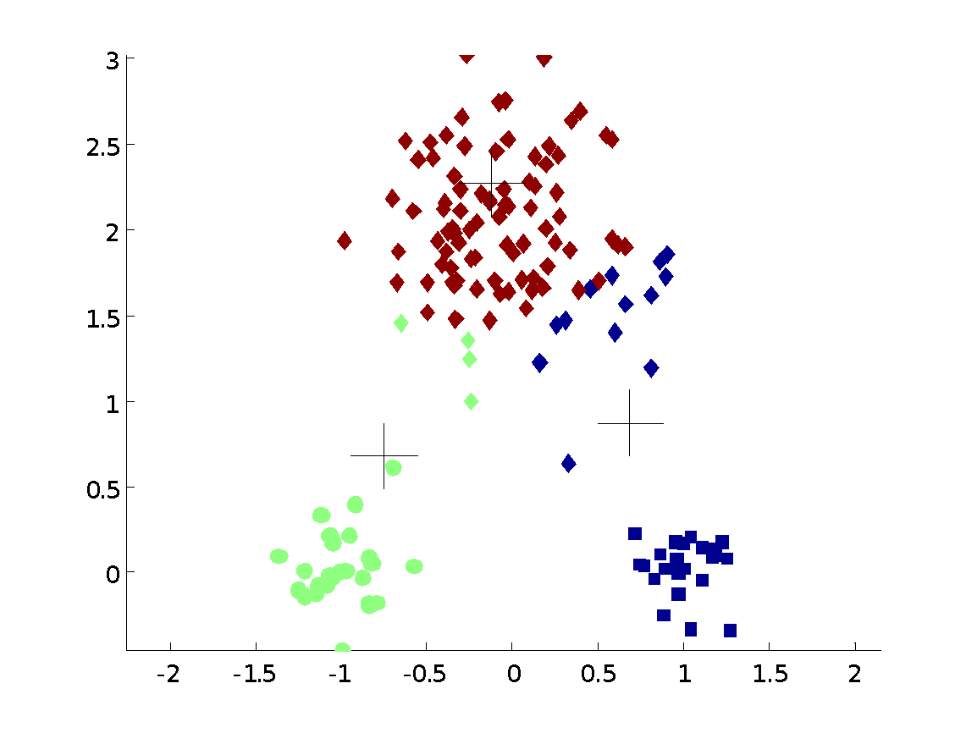
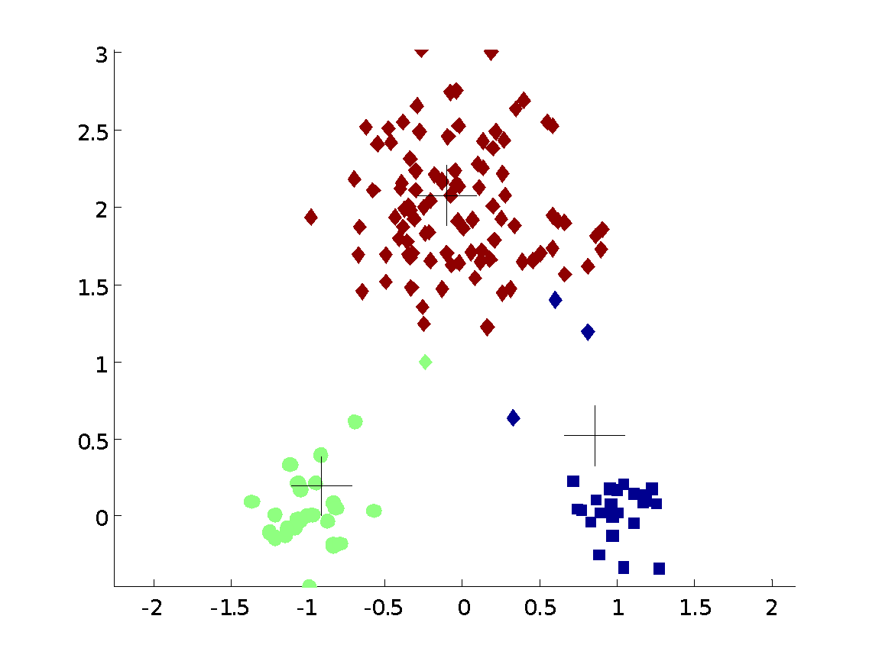


Importance of Choosing Initial Centroids
Dr. Faisal Kamiran Information Technology University of The Punjab

Slide 22
Importance of Choosing Initial Centroids
Dr. Faisal Kamiran Information Technology University of The Punjab

Slide 23
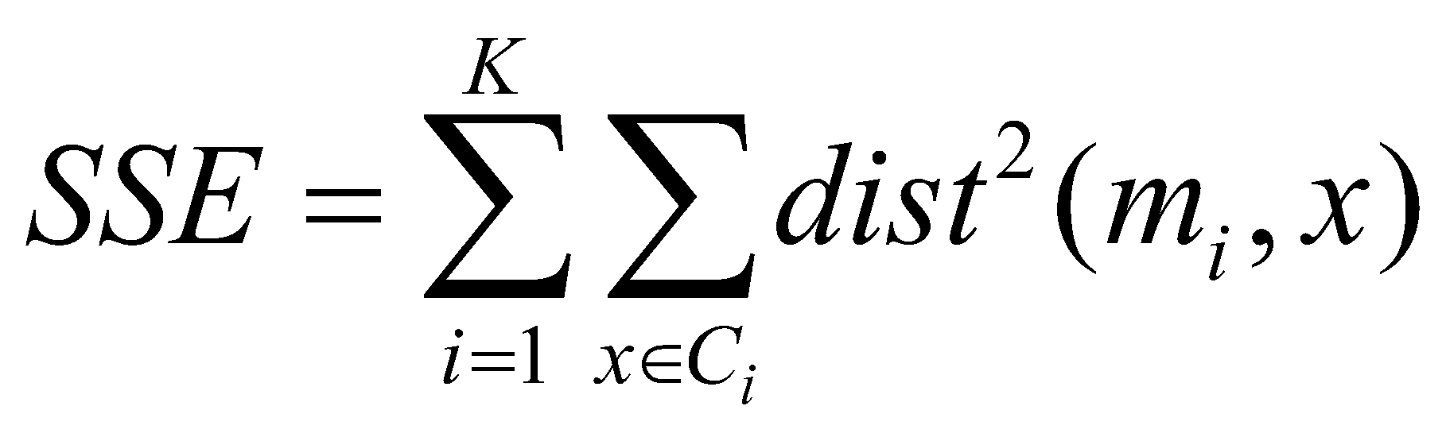
Evaluating K-means Clusters
Most common measure is Sum of Squared Error (SSE)
For each point, the error is the distance to the nearest cluster
To get SSE, we square these errors and sum them.
x is a data point in cluster C_{i} and m_{i} is the representative point for cluster C_{i}
can show that m_{i} corresponds to the center (mean) of the cluster
Given two clusters, we can choose the one with the smallest error
One easy way to reduce SSE is to increase K, the number of clusters
A good clustering with smaller K can have a lower SSE than a poor clustering with higher K
Dr. Faisal Kamiran Information Technology University of The Punjab

Slide 24
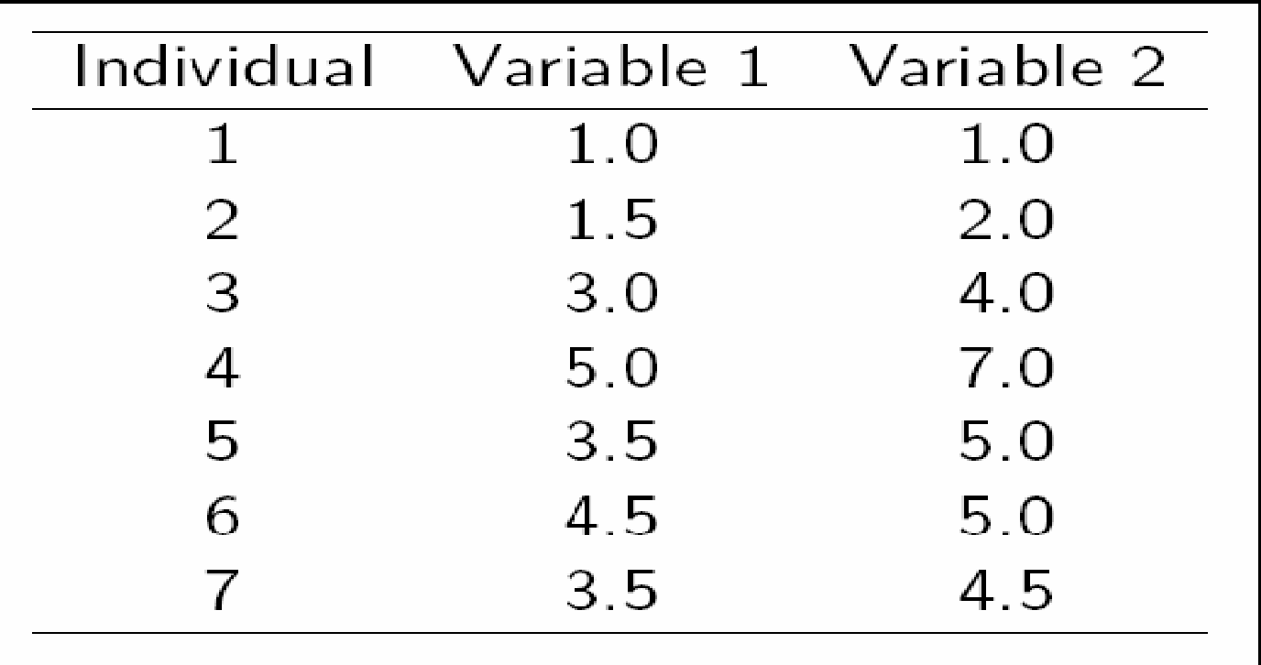
A Simple Example of k-means working
Let K=2
Dr. Faisal Kamiran Information Technology University of The Punjab

Slide 25
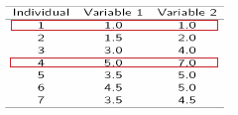
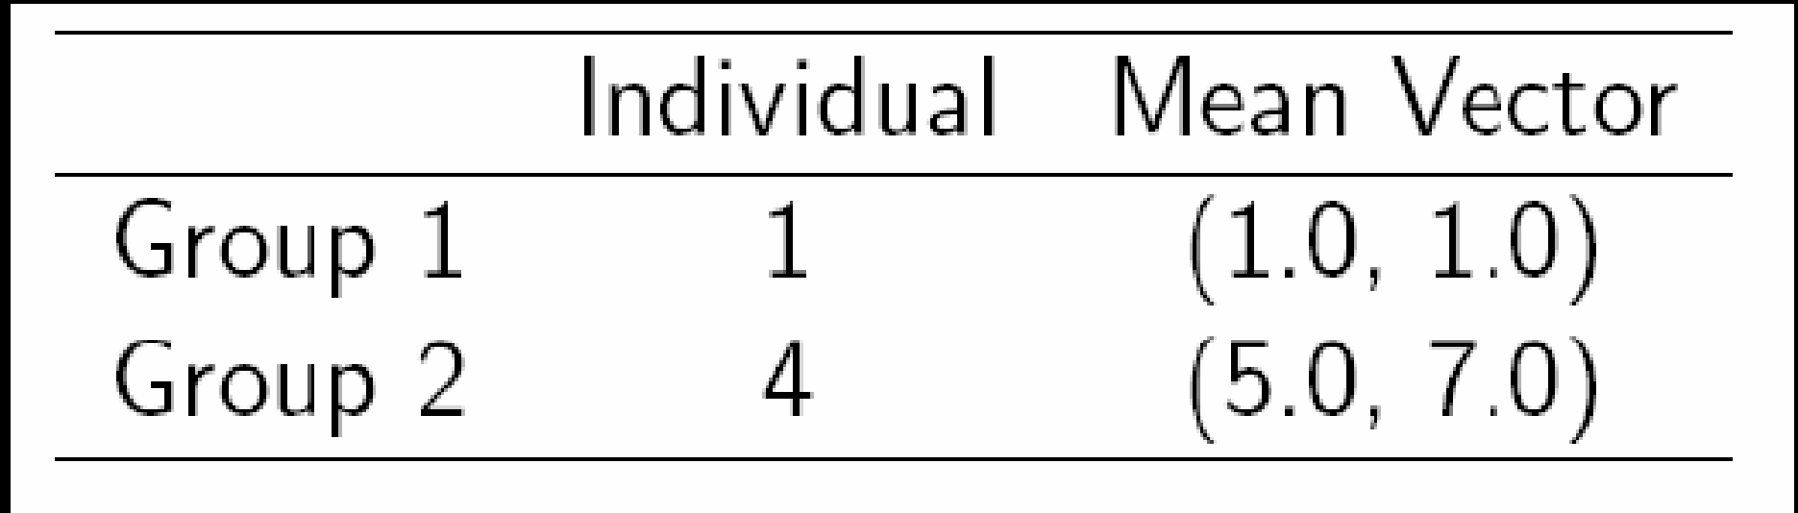
A Simple Example of k-means working
Step 1:
Initialization: Randomly we choose following two centroids (k=2) for two clusters. In this case the 2 centroid are: m1=(1.0,1.0) and m2=(5.0,7.0).
Dr. Faisal Kamiran Information Technology University of The Punjab

Slide 26
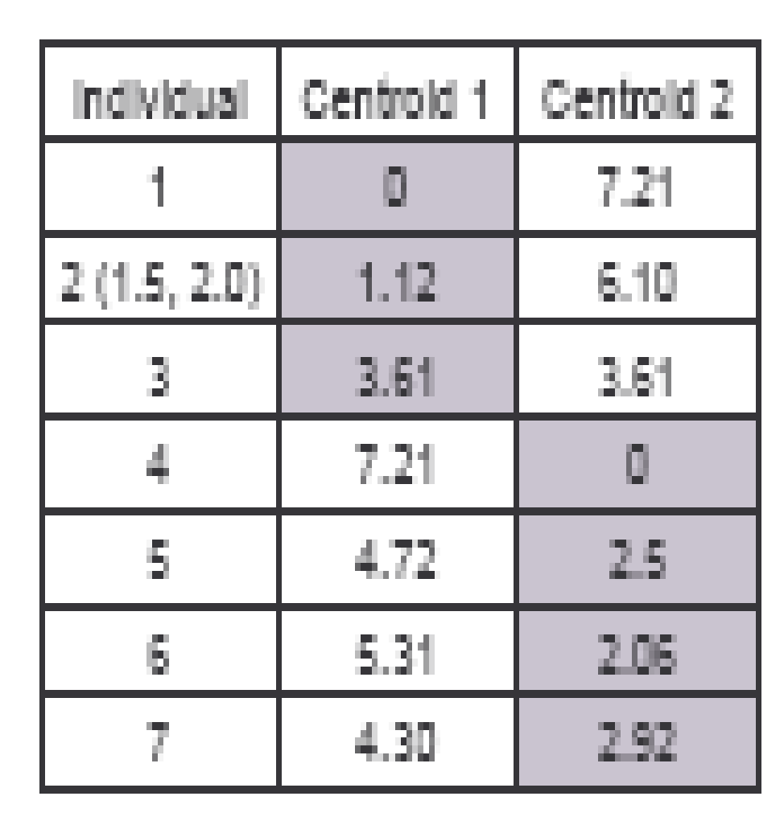



Step 2:
Thus, we obtain two clusters containing:
{1,2,3} and {4,5,6,7}.
Their new centroids are:
Dr. Faisal Kamiran Information Technology University of The Punjab

Slide 27
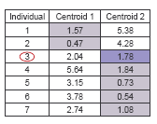

Step 3:
Now using these centroids we compute the Euclidean distance of each object, as shown in table.
Therefore, the new clusters are:
{1,2} and {3,4,5,6,7}
Next centroids are: m1=(1.25,1.5) and m2 = (3.9,5.1)
Dr. Faisal Kamiran Information Technology University of The Punjab

Slide 28
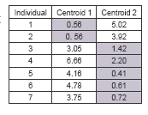
Step 4 :
The clusters obtained are:
{1,2} and {3,4,5,6,7}
Therefore, there is no change in the cluster.
Thus, the algorithm comes to a halt here and final result consist of 2 clusters {1,2} and {3,4,5,6,7}.
Dr. Faisal Kamiran Information Technology University of The Punjab

Slide 29
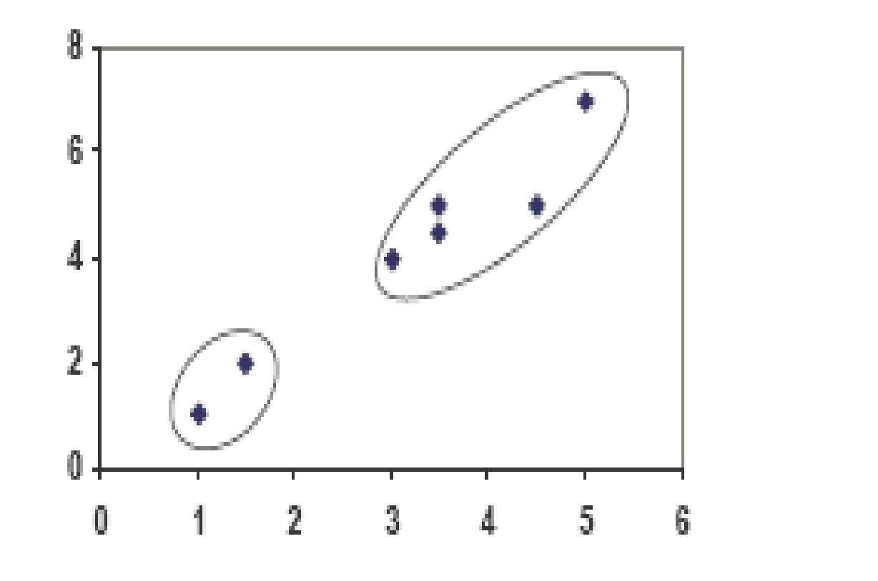
PLOT
Dr. Faisal Kamiran Information Technology University of The Punjab

Slide 30
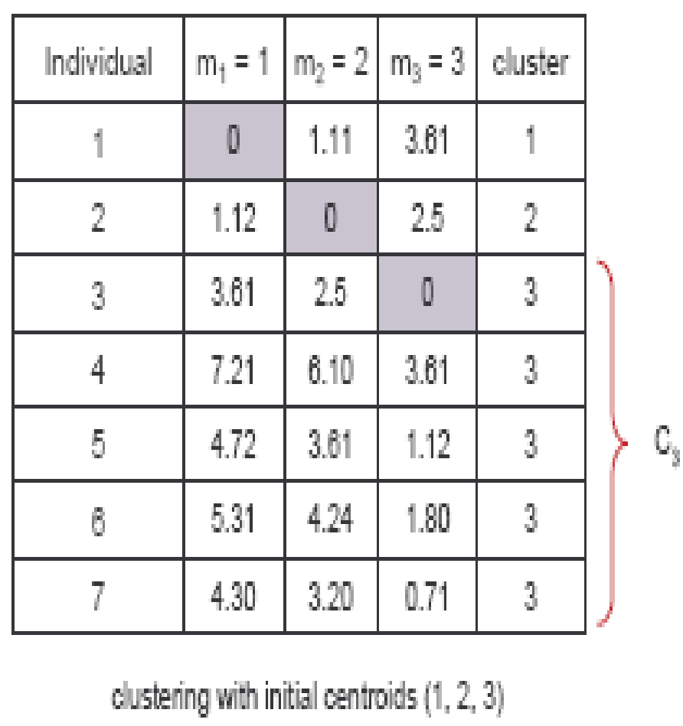
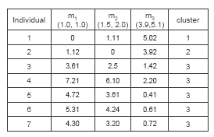
Example with K=3
Step 1
Step 2
Dr. Faisal Kamiran Information Technology University of The Punjab

Slide 31
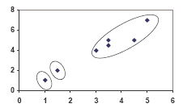
PLOT
Dr. Faisal Kamiran Information Technology University of The Punjab

Slide 32
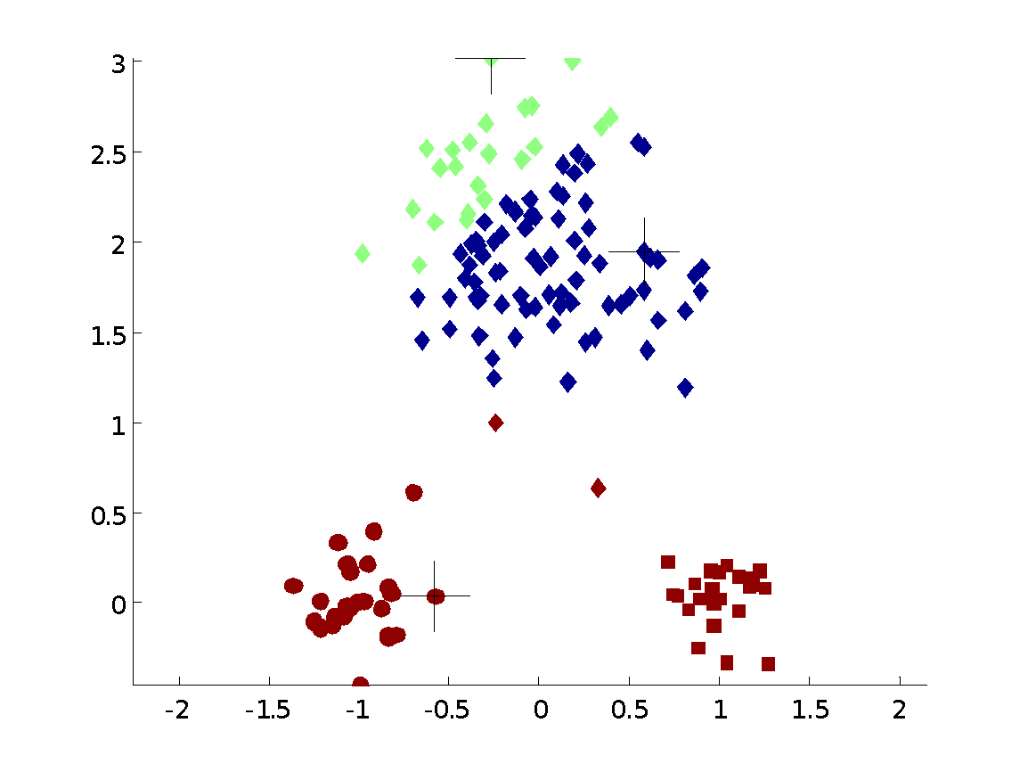
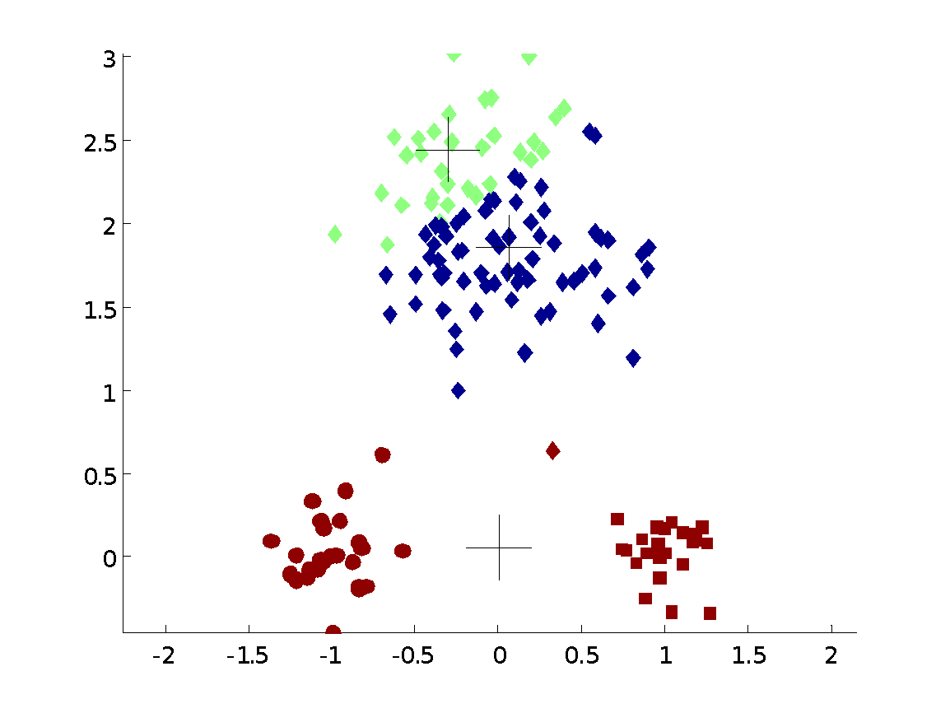
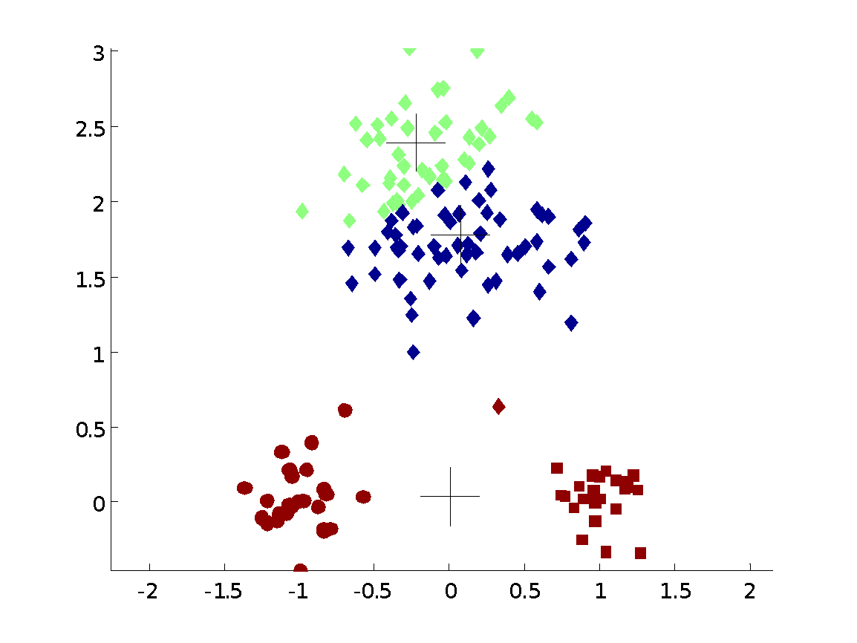
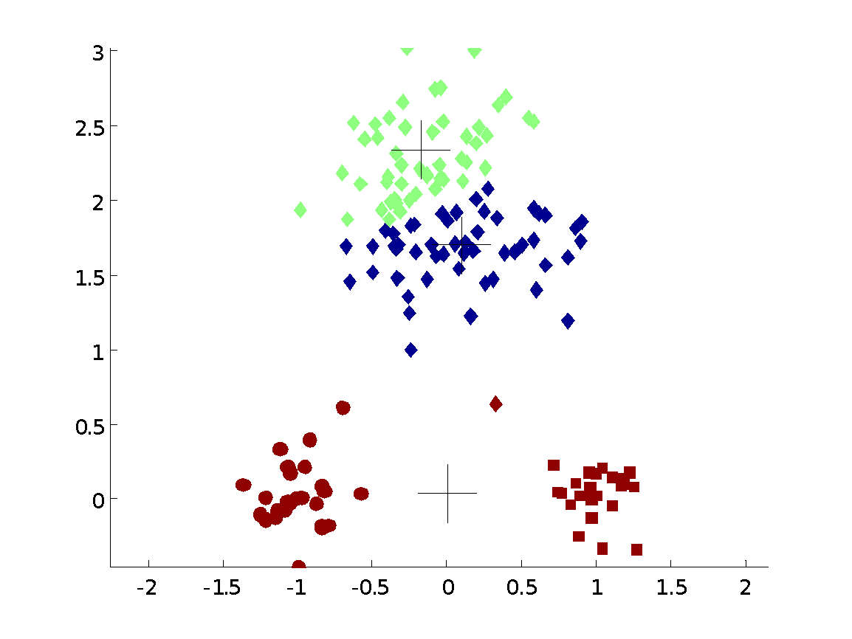

Importance of Choosing Initial Centroids …
Dr. Faisal Kamiran Information Technology University of The Punjab

Slide 33
Importance of Choosing Initial Centroids …
Dr. Faisal Kamiran Information Technology University of The Punjab

Slide 34
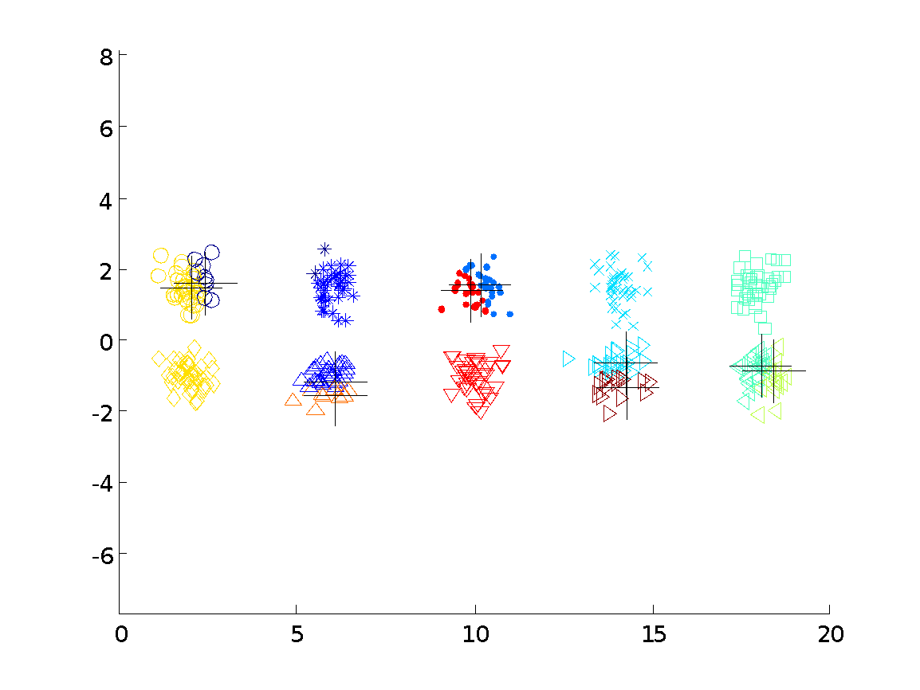
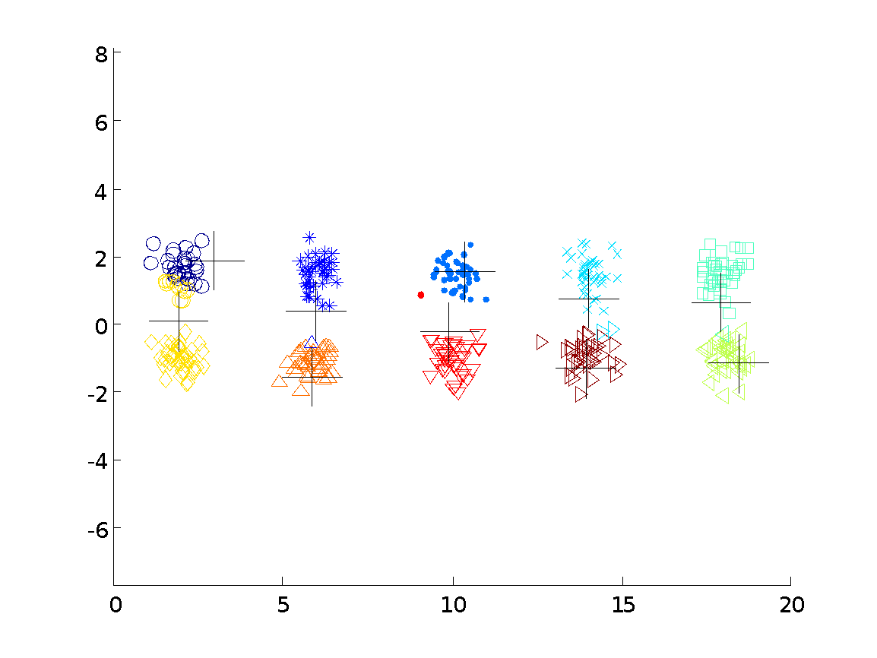
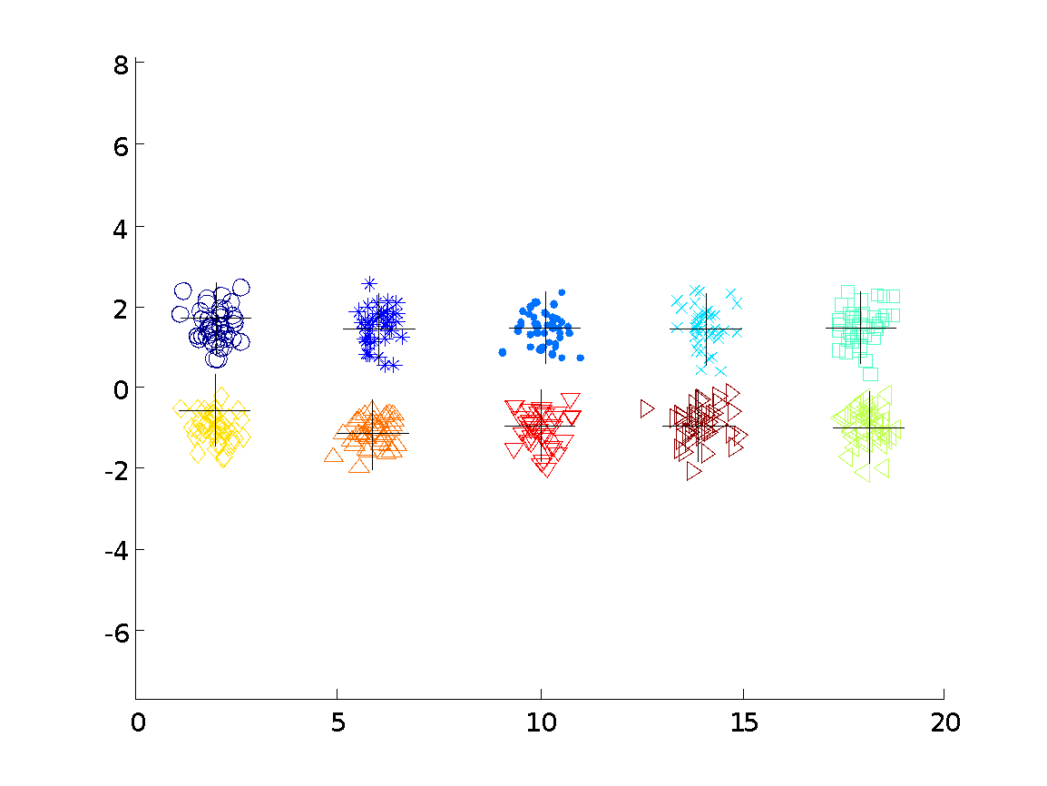

10 Clusters Example
Starting with two initial centroids in one cluster of each pair of clusters
Dr. Faisal Kamiran Information Technology University of The Punjab

Slide 35
10 Clusters Example
Starting with two initial centroids in one cluster of each pair of clusters
Dr. Faisal Kamiran Information Technology University of The Punjab

Slide 36
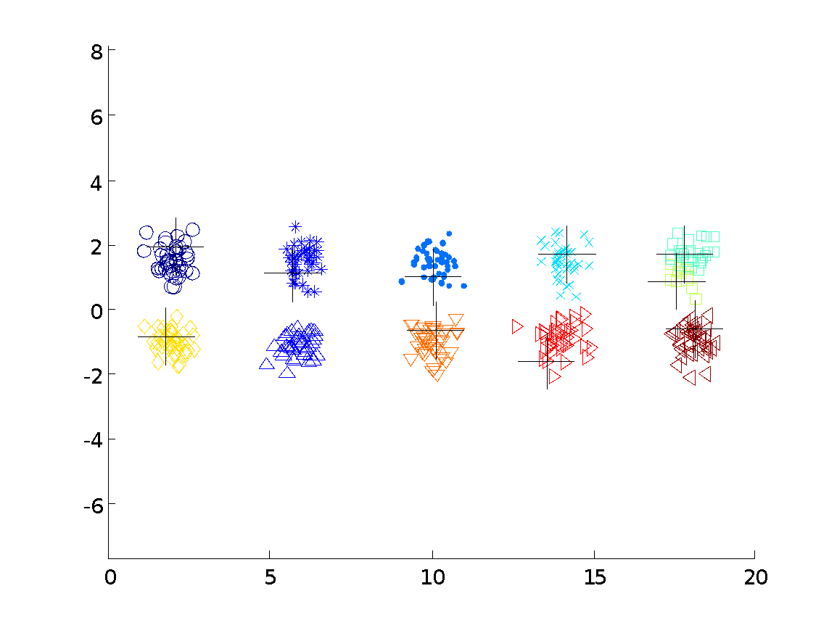



10 Clusters Example
Starting with some pairs of clusters having three initial centroids, while other have only one.
Dr. Faisal Kamiran Information Technology University of The Punjab

Slide 37
10 Clusters Example
Starting with some pairs of clusters having three initial centroids, while other have only one.
Dr. Faisal Kamiran Information Technology University of The Punjab

Slide 38
Solutions to Initial Centroids Problem
Multiple runs
Helps, but probability is not on your side
Sample and use hierarchical clustering to determine initial centroids
Select more than k initial centroids and then select among these initial centroids
Select most widely separated
Postprocessing
Bisecting K-means
Not as susceptible to initialization issues
Dr. Faisal Kamiran Information Technology University of The Punjab

Slide 39
Updating Centers Incrementally
In the basic K-means algorithm, centroids are updated after all points are assigned to a centroid
An alternative is to update the centroids after each assignment (incremental approach)
Each assignment updates zero or two centroids
More expensive
Introduces an order dependency
Can use “weights” to change the impact
Dr. Faisal Kamiran Information Technology University of The Punjab

Slide 40
Pre-processing and Post-processing
Pre-processing
Normalize the data
Eliminate outliers
Post-processing
Eliminate small clusters that may represent outliers
Split ‘loose’ clusters, i.e., clusters with relatively high SSE
Merge clusters that are ‘close’ and that have relatively low SSE
Can use these steps during the clustering process
Dr. Faisal Kamiran Information Technology University of The Punjab

Slide 41
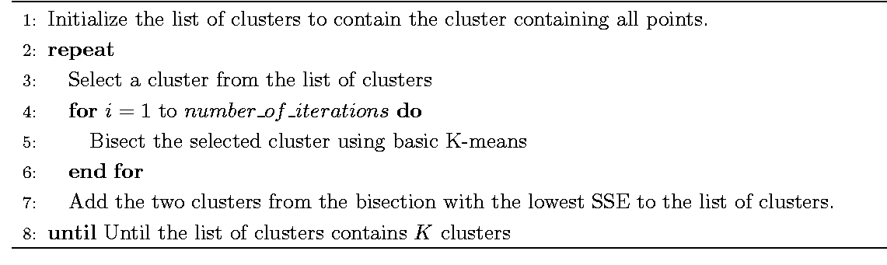
Bisecting K-means
Bisecting K-means algorithm
Variant of K-means that can produce a partitional or a hierarchical clustering

Slide 42
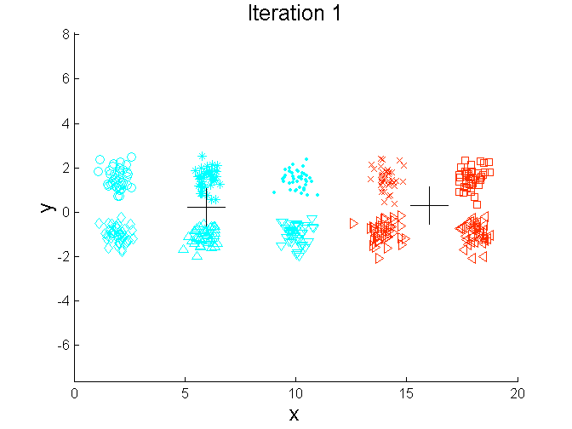
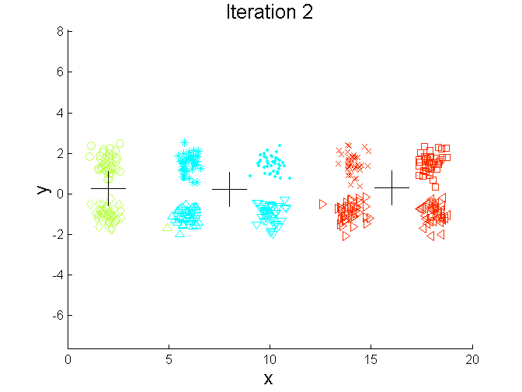
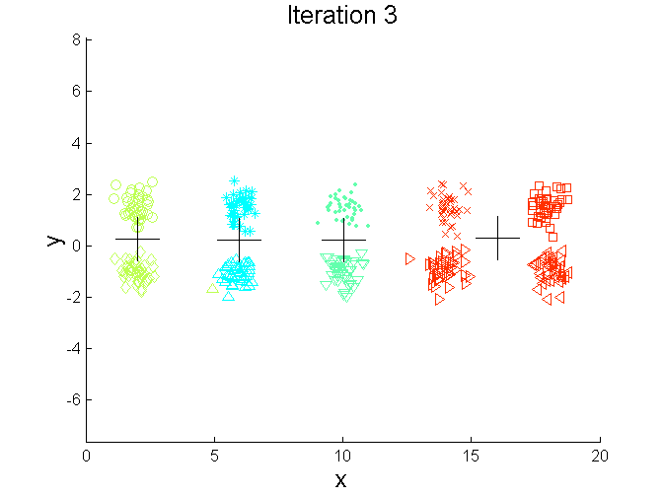
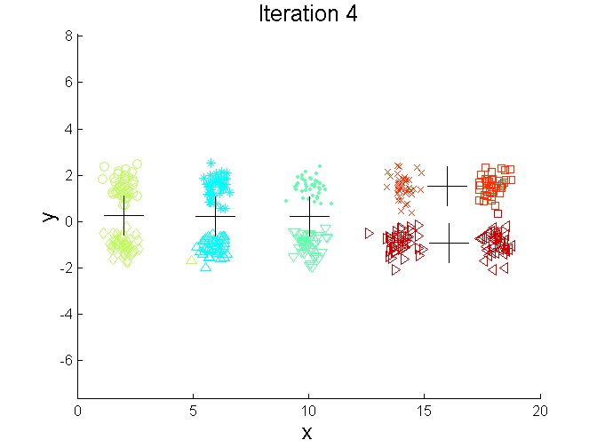
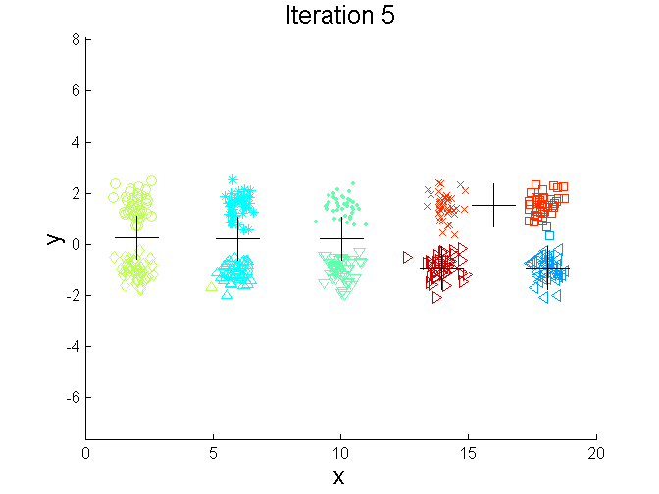
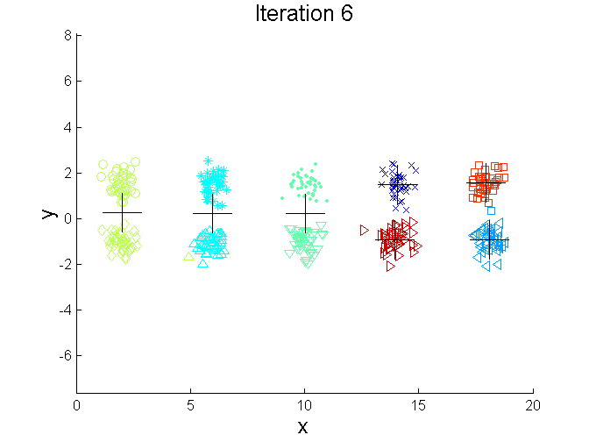
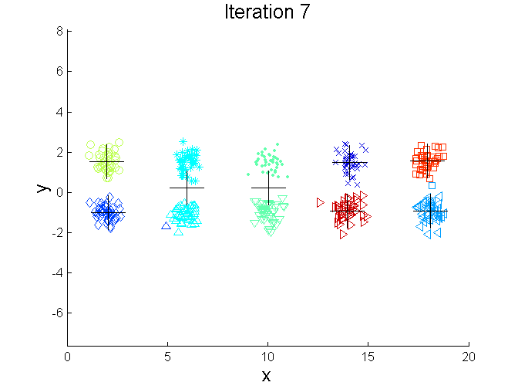
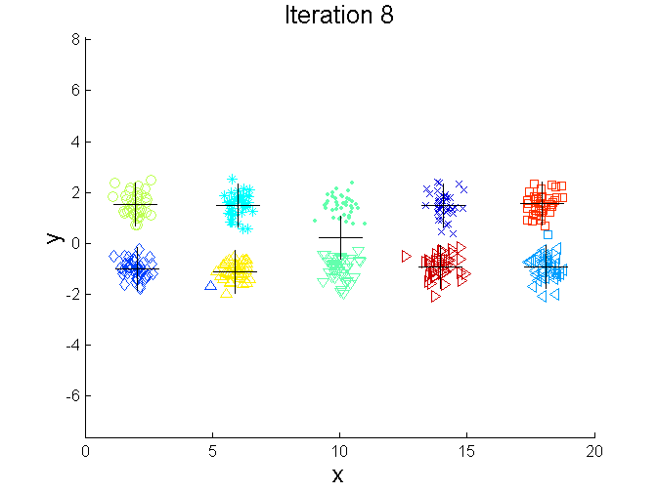
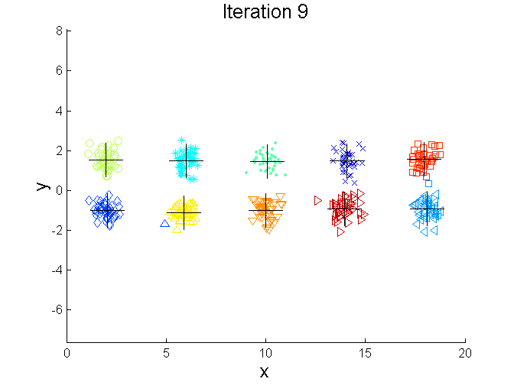
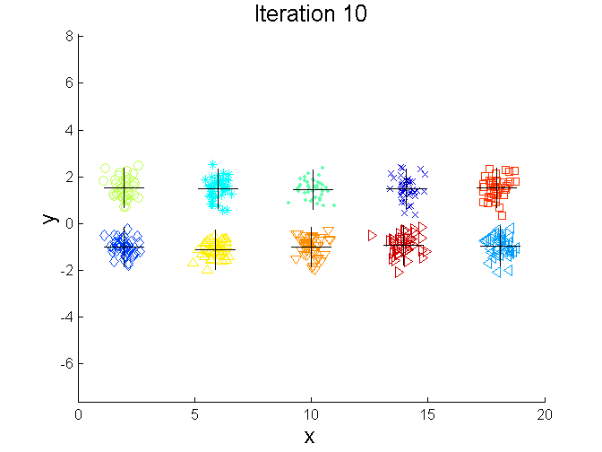
Bisecting K-means Example

Slide 43
Strengths of K-means
Simple algorithm
Can handle wide variety of data
Quite efficient

Slide 44
Limitations of K-means
K-means has problems when clusters are of differing
Sizes
Densities
Non-globular shapes
K-means has problems when the data contains outliers.

Slide 45
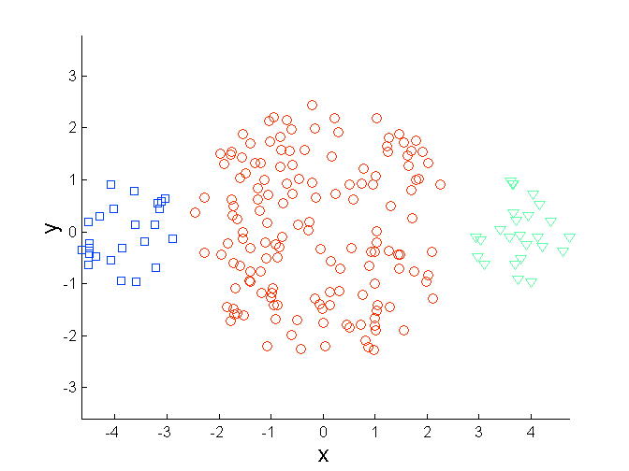
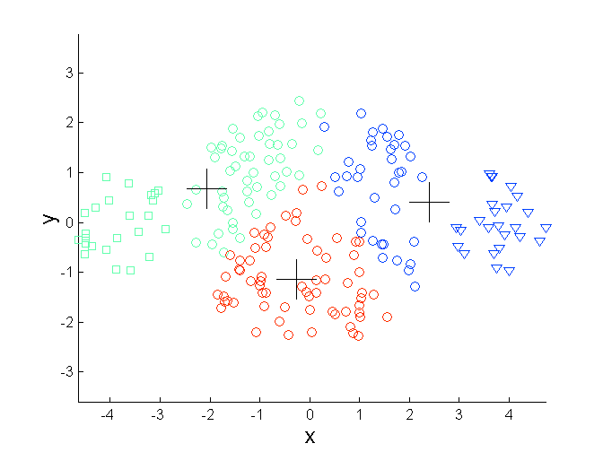
Limitations of K-means: Differing Sizes
Original Points
K-means (3 Clusters)

Slide 46
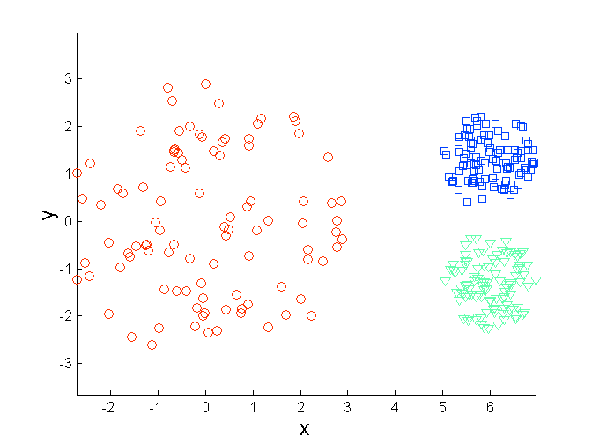
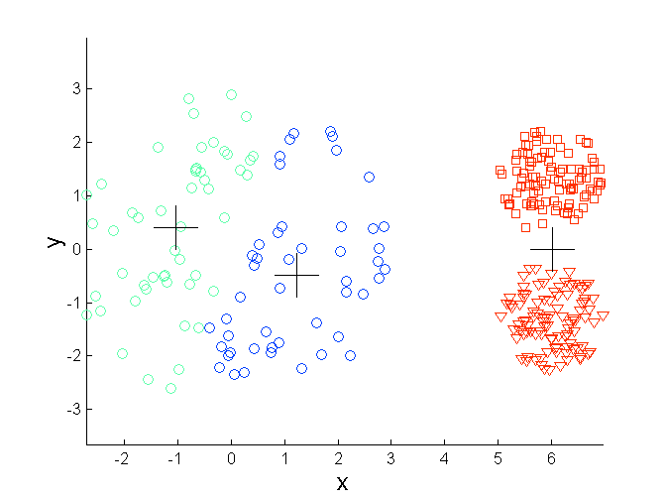
Limitations of K-means: Differing Density
Original Points
K-means (3 Clusters)

Slide 47
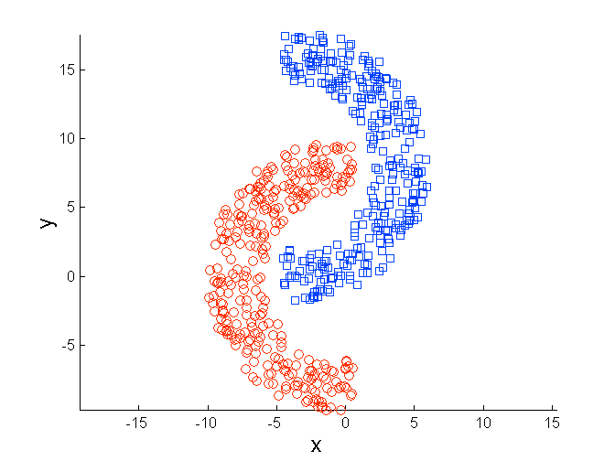
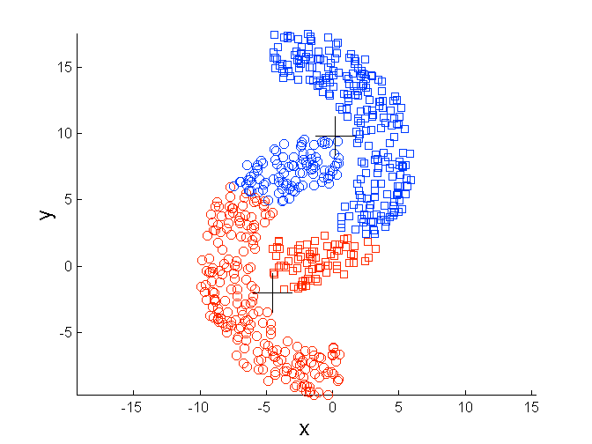
Limitations of K-means: Non-globular Shapes
Original Points
K-means (2 Clusters)

Slide 48
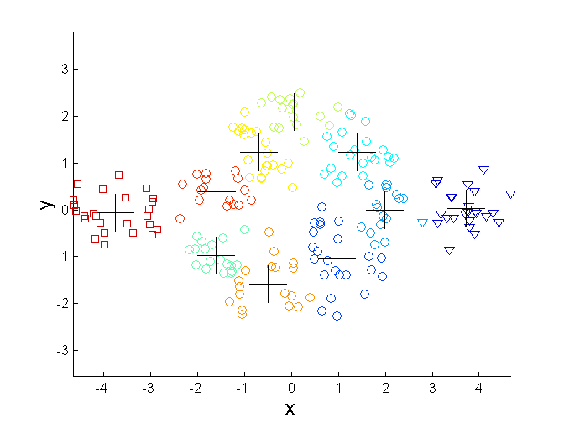
Overcoming K-means Limitations
Original Points K-means Clusters
One solution is to use many clusters.
Find parts of clusters, but need to put together.

Slide 49

Overcoming K-means Limitations
Original Points K-means Clusters

Slide 50

Overcoming K-means Limitations
Original Points K-means Clusters

